Slide 1

Final Presentation
Programming for Engineer II
PROJECT B3
B3
CHAEYOON YU
HEECHAN YU
KAEDING FABIAN BURCHERT
1

Slide 2
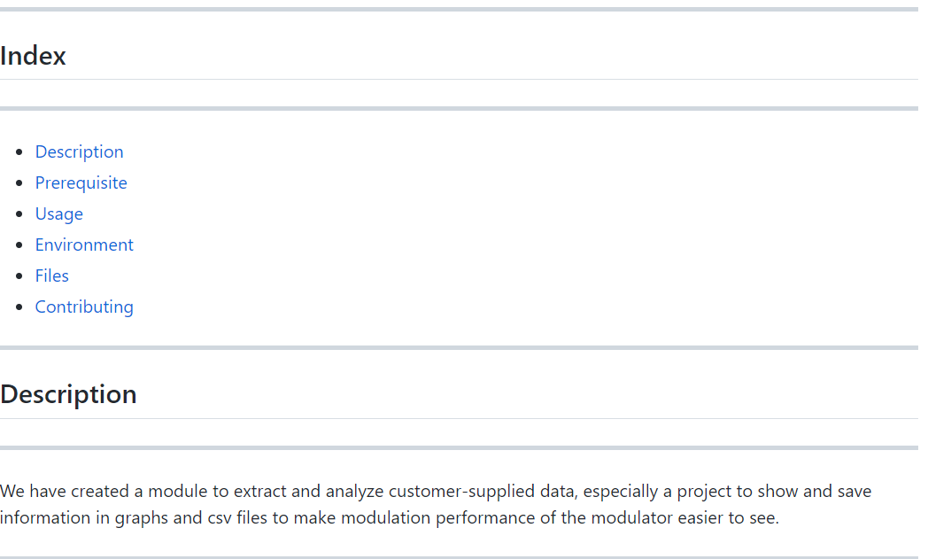
INDEX and Description in README.md
https://github.com/HYUB3/project.git
2

Slide 3
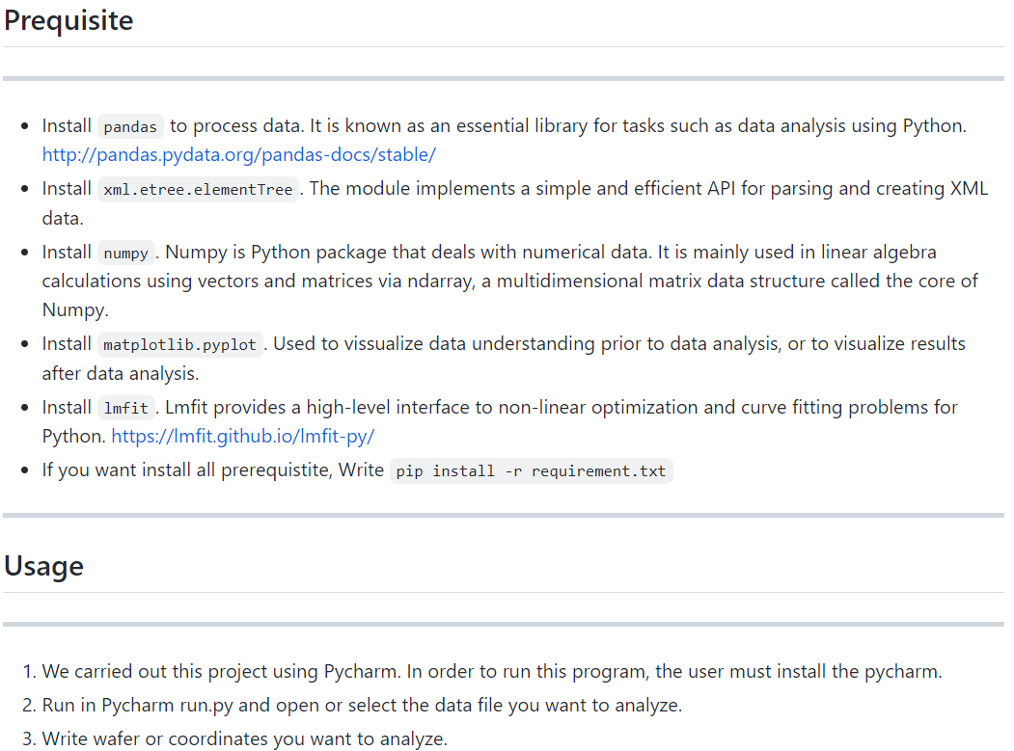
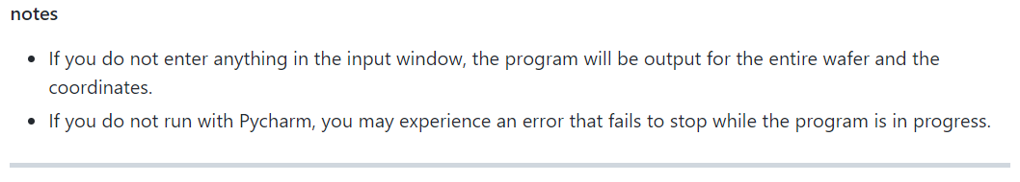
3

Slide 4
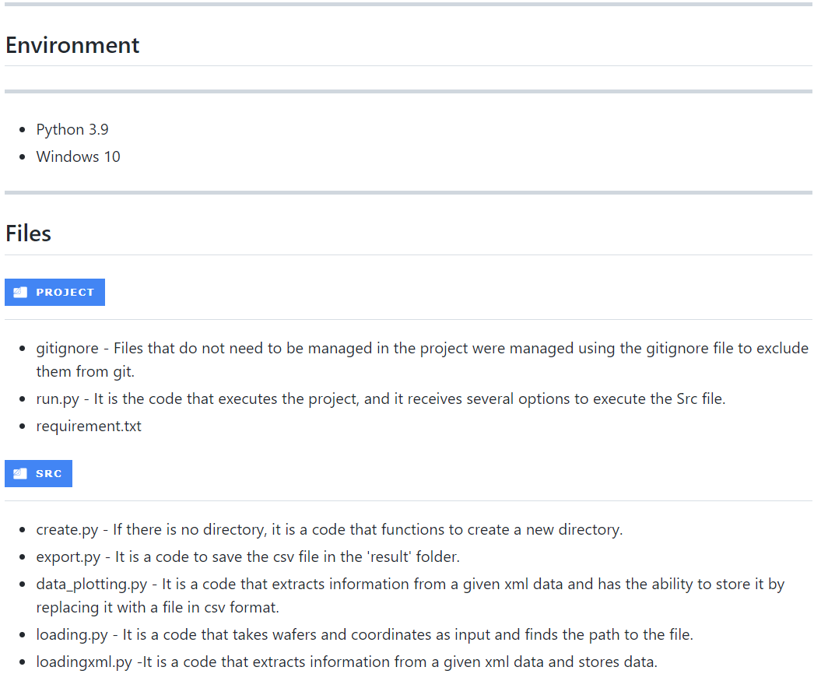
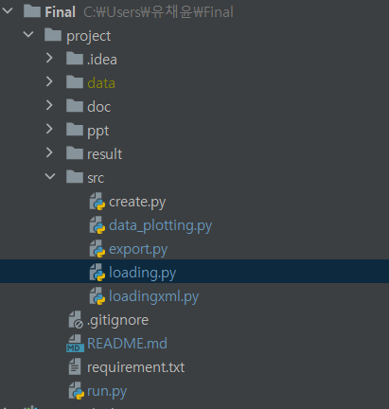
4

Slide 5
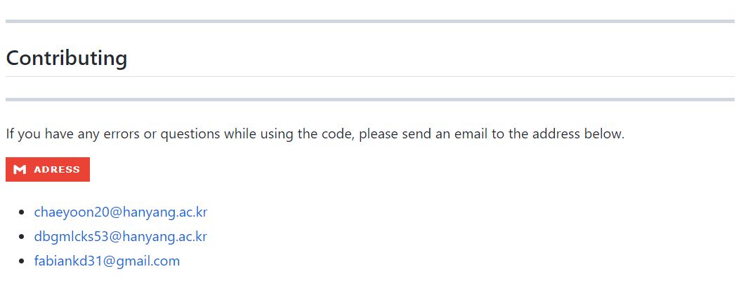
5

Slide 6
Algorithm of Project B3
Saving data
in xml file
Saving .png files
Saving .csv files
Run.py
Loading.py
Loading
xml.py
data_
plotting.py
export.py
Inputting
Wafer and coordinate
Saving path of xml
Plotting
Fitting
The program is working!
6

Slide 7
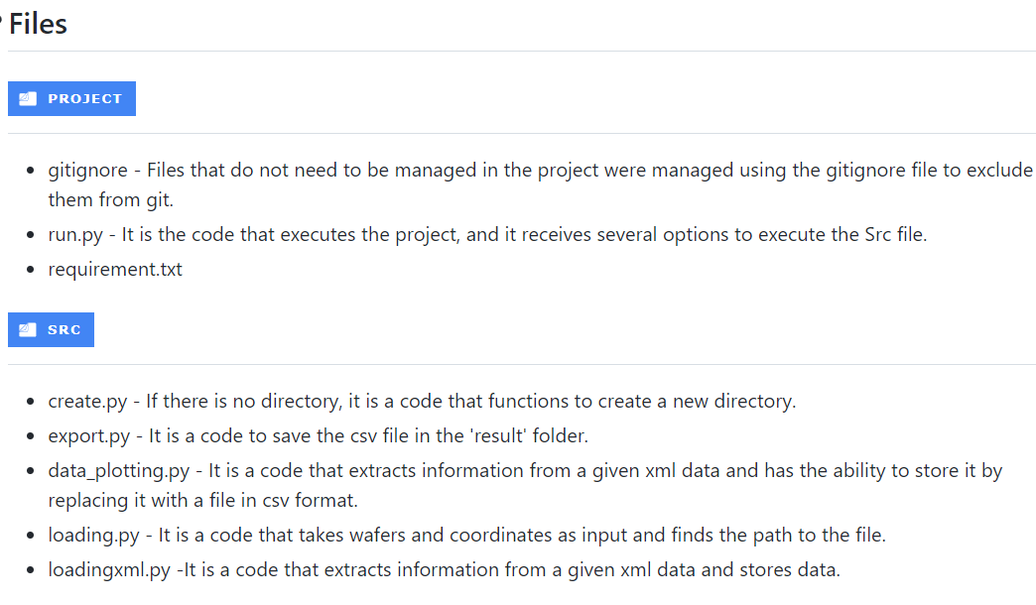
Files - Project and src
7

Slide 8
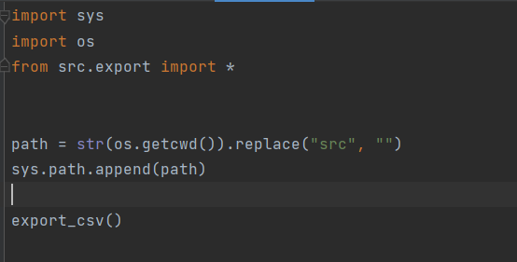
Files – run.py in Project
Status of project B3
Run.py
Loading.py
Loading
xml.py
data_
plotting.py
export.py
8

Slide 9
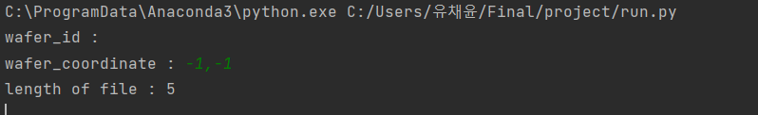
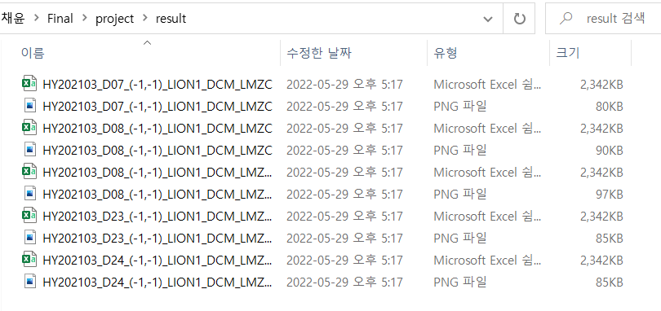
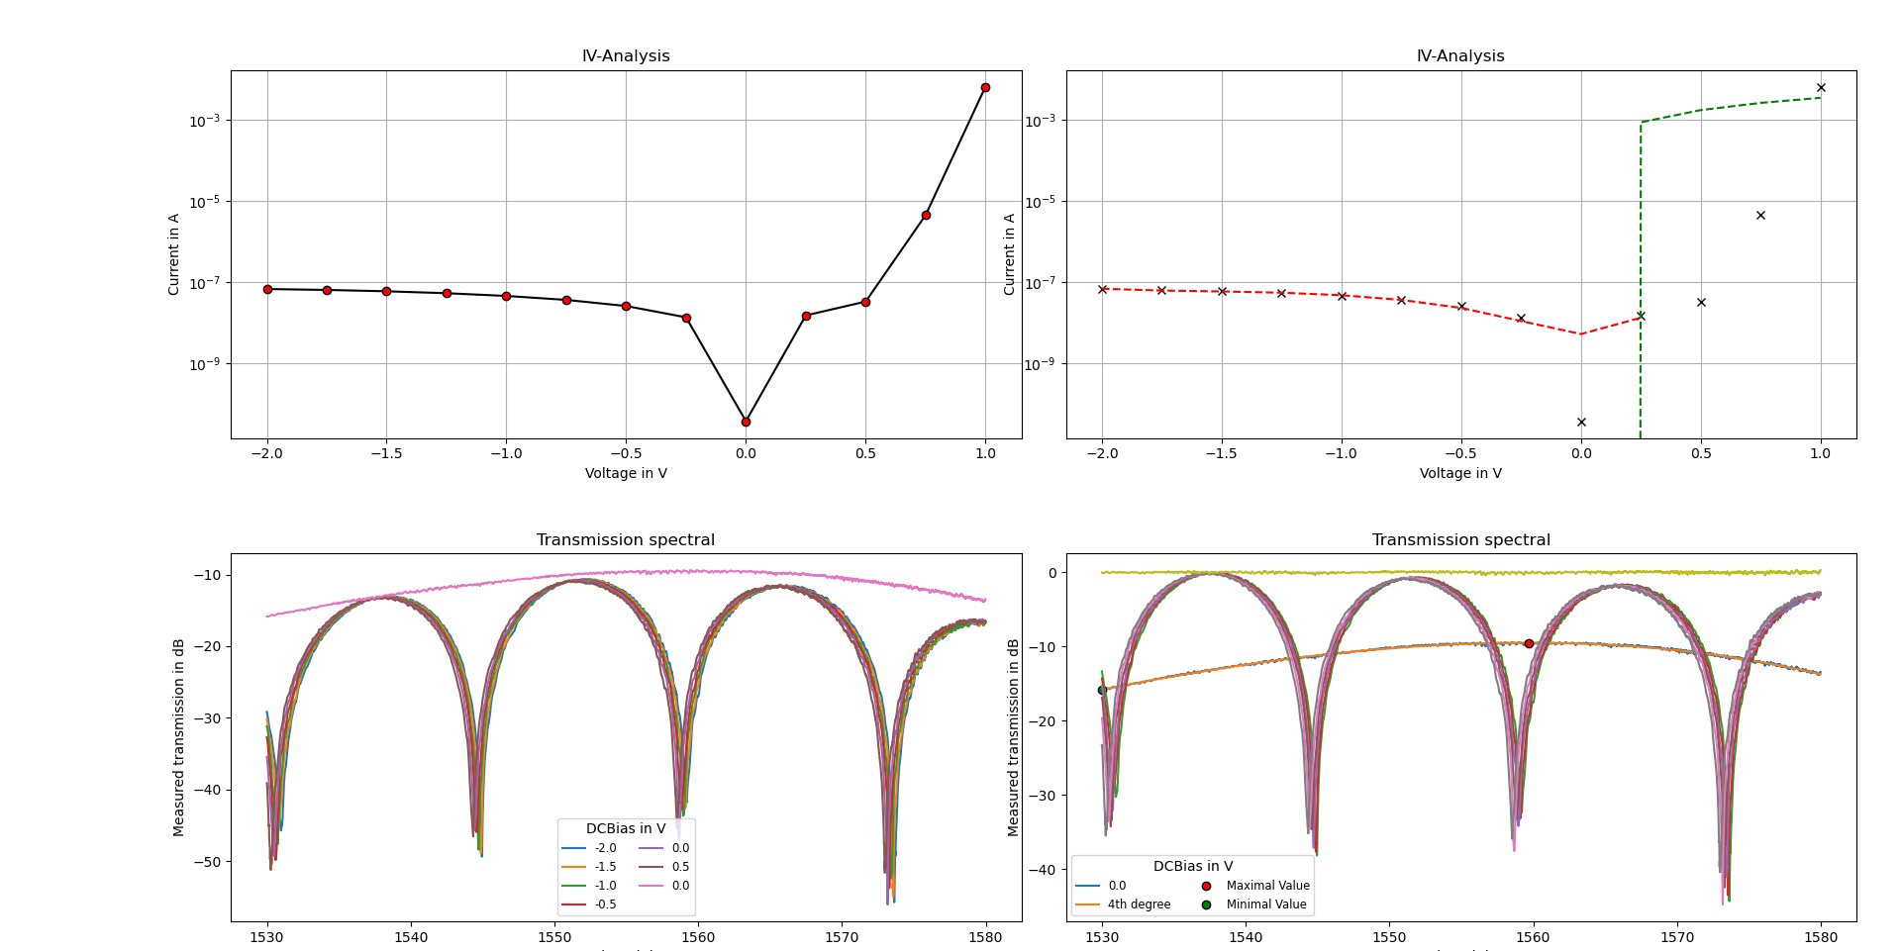
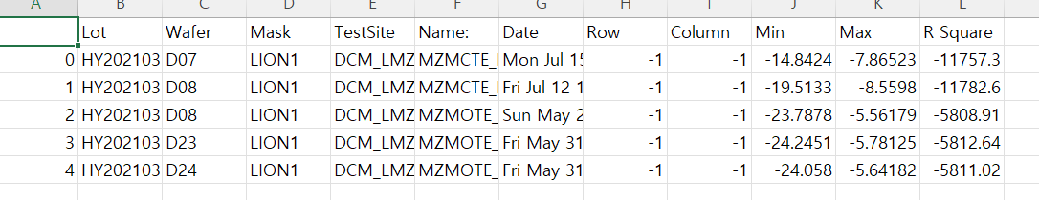
Running of run.py
Saving 5 csv files, png files each
Example
9

Slide 10
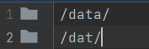
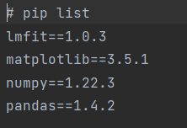
Files – .gitignore in Project
Files – requirement.txt in Project
10

Slide 11
Files - Project and src
11

Slide 12
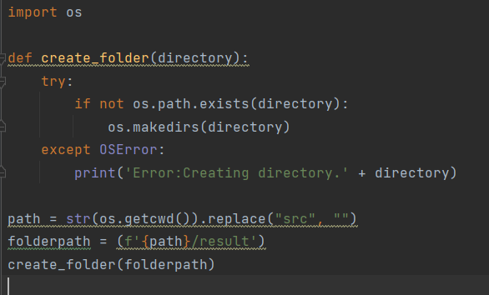
Files – src in Project
Create.py
If there is no ‘result’ directory,
it is a code that functions to create a new directory
12

Slide 13
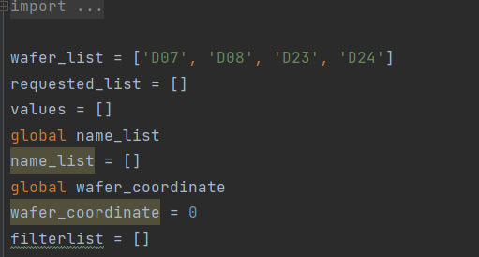
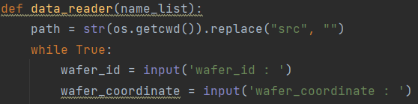
Files – src in Project
loading.py
Status of project B3
Run.py
Loading.py
Loading
xml.py
data_
plotting.py
export.py
13

Slide 14
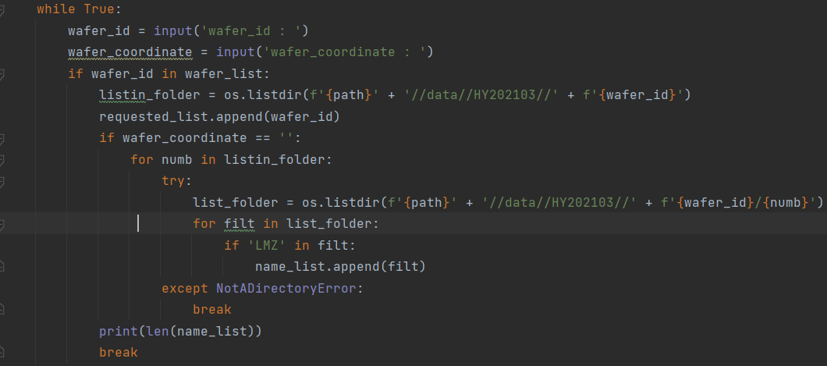
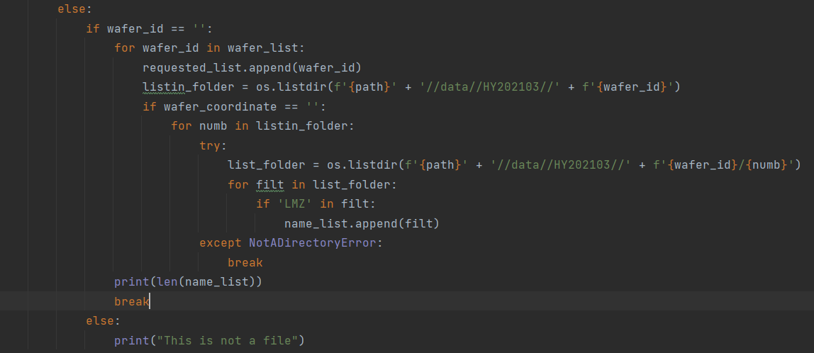
Files – src in Project
loading.py
14

Slide 15
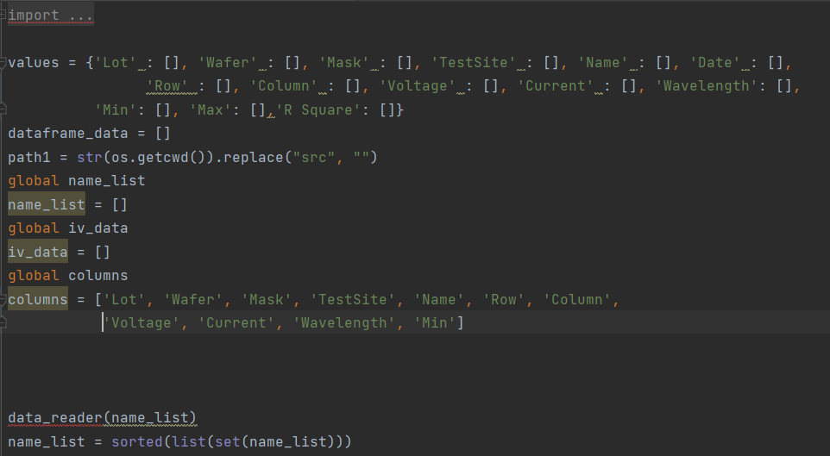
Files – src in Project
loadingxml.py
Status of project B3
Run.py
Loading.py
Loading
xml.py
data_
plotting.py
export.py
15

Slide 16
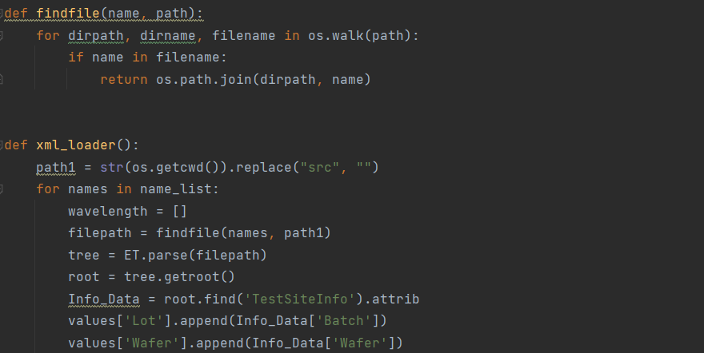
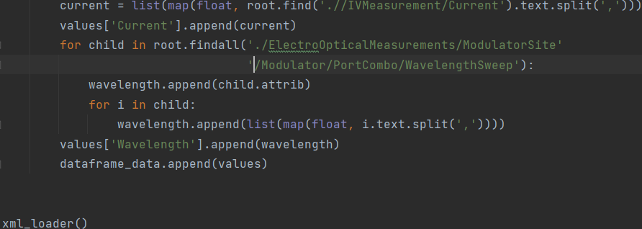
Files – src in Project
loadingxml.py
▪ ▪ ▪
16

Slide 17
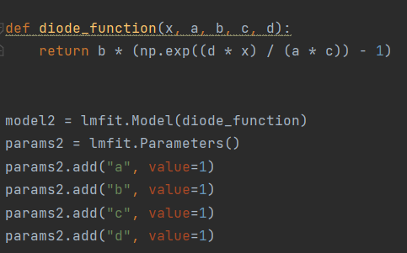
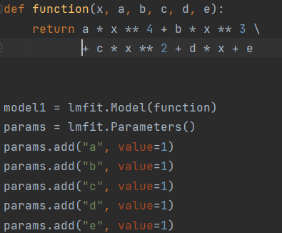
Files – src in Project
data_plotting.py
Status of project B3
Run.py
Loading.py
Loading
xml.py
data_
plotting.py
export.py
17

Slide 18
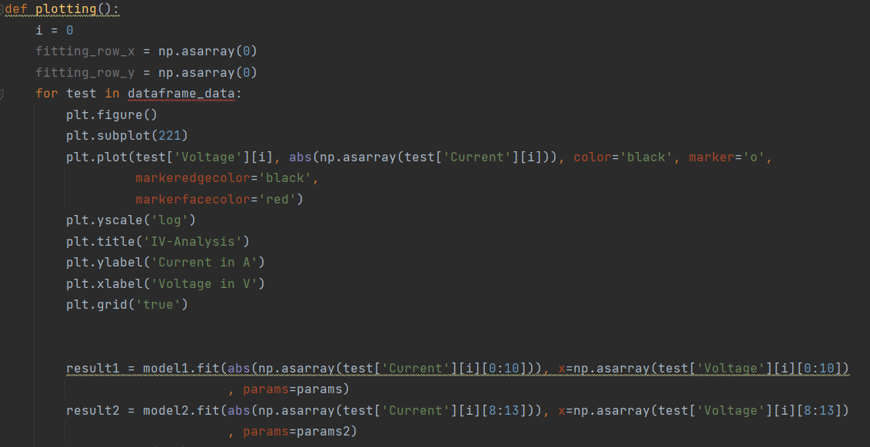
Files – src in Project
data_plotting.py
18

Slide 19
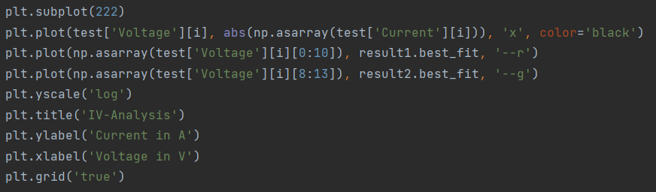
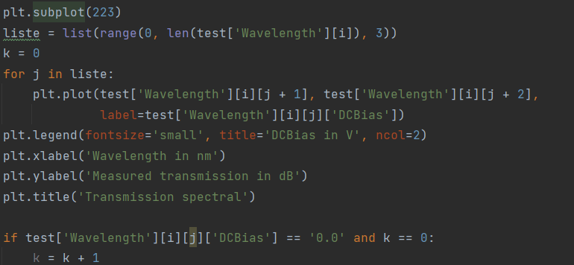
Files – src in Project
data_plotting.py
19

Slide 20
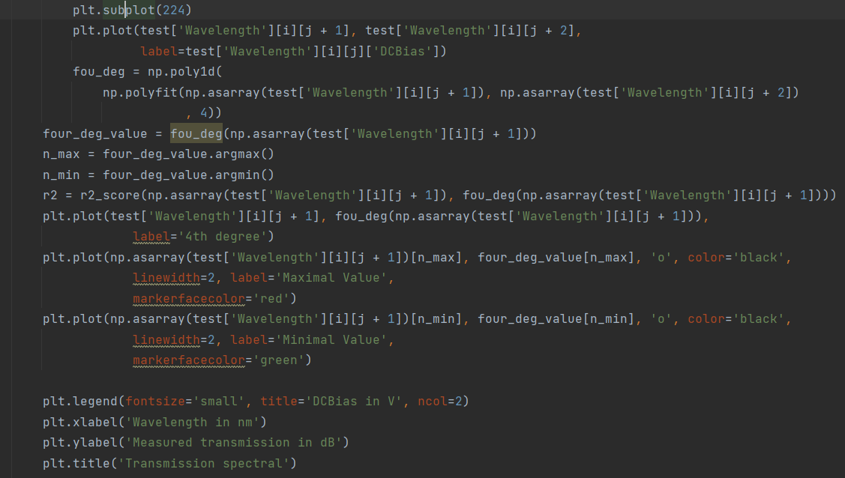
Files – src in Project
data_plotting.py
20

Slide 21
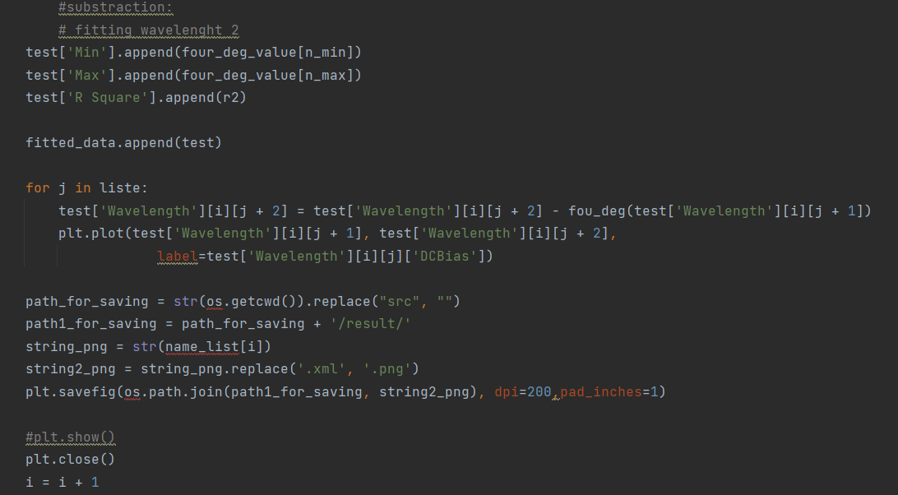
Files – src in Project
data_plotting.py
substraction
21

Slide 22
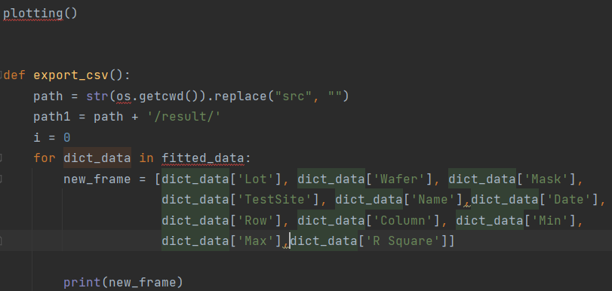
Files – src in Project
export.py
data_plotting.plotting()
Status of project B3
Run.py
Loading.py
Loading
xml.py
data_
plotting.py
export.py
22

Slide 23
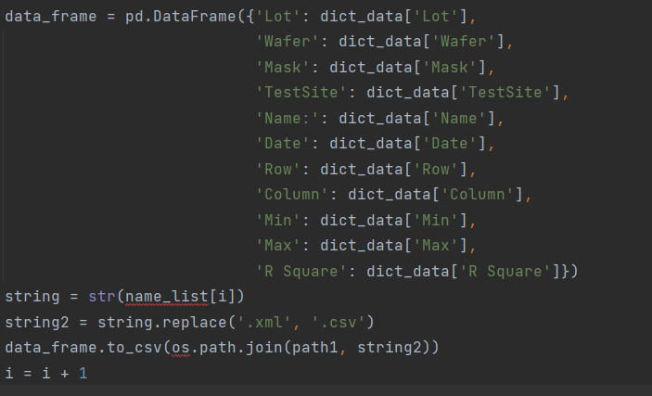
Files – src in Project
export.py
by loadingxml.py
23

Slide 24
Thank You !
Q&A

